Slide 1

VLA Elektrik/Aviyonik Grubu
Mehmet Alp ER
Halil TEMURTAŞ
Nesil BOR
Fatih YAVUZ

Slide 2
İçerik
Aviyonik Seçimi
Aviyonik Mimari
Işıklandırma Malzeme Seçimi
Elektrik Mimari

Slide 3
Aviyonik Seçimi
İstenilen Ekipman | Seçilen Aviyonik
Seyrüsefer Ekipmanı | Garmin GTN 750
Transponder | Garmin GTX 335
Hız/İrtifa Göstergesi | Garmin G500
Motor &Yakıt Kontrol Paneli | Garmin G500
Elektrik Kontrol Paneli | Garmin G500
Saat | Garmin G500
ELT (Emergency Locator Transmitter) | Artex ME 406 ELT
Magnetic Compass | Garmin G500
Statik Port | Garmin G500
Pitot Tube | Garmin G500
Stall Uyarısı | Garmin G500?
Haberleşme Sistemi | Garmin GMA 340

Slide 4
Aviyonik Seçimi
Requirement | Chosen Avionics
ODTÜ-VLA-SRD-017 | Garmin G500-Garmin GTN 750
ODTÜ-VLA-SRD-018 | Garmin G500-Garmin GTN 750
ODTÜ-VLA-SRD-019 | Garmin G500-Garmin GTN 750
ODTÜ-VLA-SRD-020 | Garmin G500-Garmin GTN 750
ODTÜ-VLA-SRD-021 | Garmin G500-Garmin GTN 750
ODTÜ-VLA-SRD-022 | Garmin GTN 750
ODTÜ-VLA-SRD-023 | Garmin GTN 750-Garmin GTX 335
ODTÜ-VLA-SRD-024 | Garmin GMA 340
ODTÜ-VLA-SRD-026 | Garmin GTN 750
ODTÜ-VLA-SRD-027 | Garmin GTN 750
ODTÜ-VLA-SRD-028 | Garmin GTN 750
ODTÜ-VLA-SRD-029 | Artex ME406 ELT
ODTÜ-VLA-SRD-030 | Garmin GTX 335
ODTÜ-VLA-SRD-025 | Garmin GMA 340

Slide 5
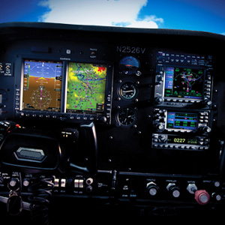
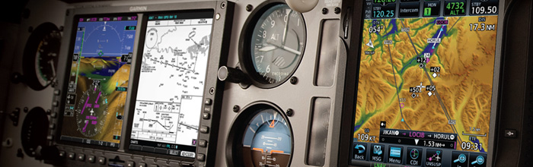
Aviyonik Seçimi
j

Slide 6
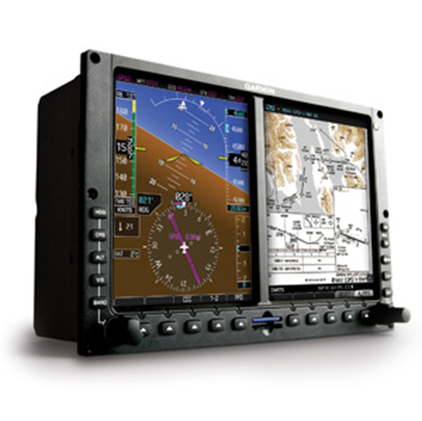
Garmin G500
Dual 6.5" diagonal color LCD
Competible with other Garmin Avionics
GTN 750
GTX 335
GMA 340
Includes required equipments
Static Port
Pitot Tube etc.

Slide 7
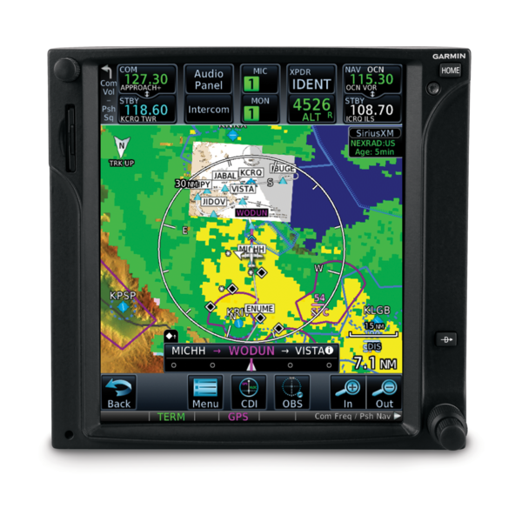
Garmin GTN 750
GPS/NAV/COMM/MFD
Seyrüsefer Ekipmanı
Visualizes your entire flight plan
Competible with other Garmin Avionics
G500
GTX 335

Slide 8
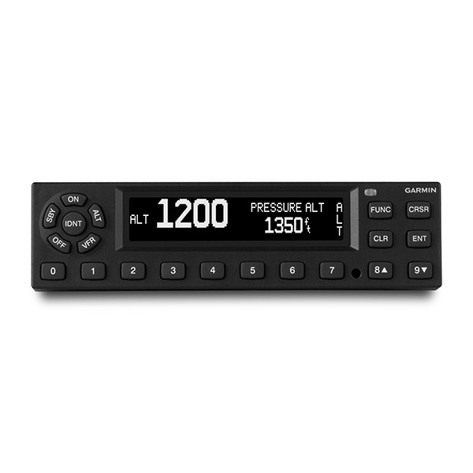
Garmin GTX 335
1090 MHz ADS-B “Out” Transponder
Competible with other Garmin Avionics
G500
GTN 750
1090 MHz output enables aircraft to operate at any altitude, in airspace around the globe

Slide 9
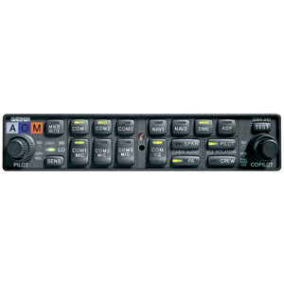
Garmin GMA 340
Audio panel
LED-illuminated button controls
Provides MASQ processing
reduces ambient noise from the avionics inputs
two unswitched inputs for telephone ringers
altitude alert warnings
other warning tones

Slide 10
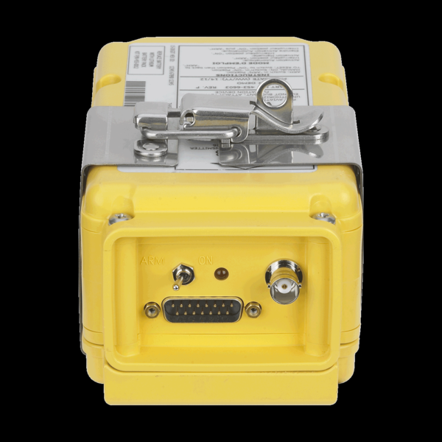
Artex ME406 ELT
406 MHz Emergency Locator Transmitter
Activating the ELT
the 406 MHz transmitter sends an encoded
signal every 50 seconds to alert search and
rescue teams of your location

Slide 11
Aviyonik Seçimi

Slide 12
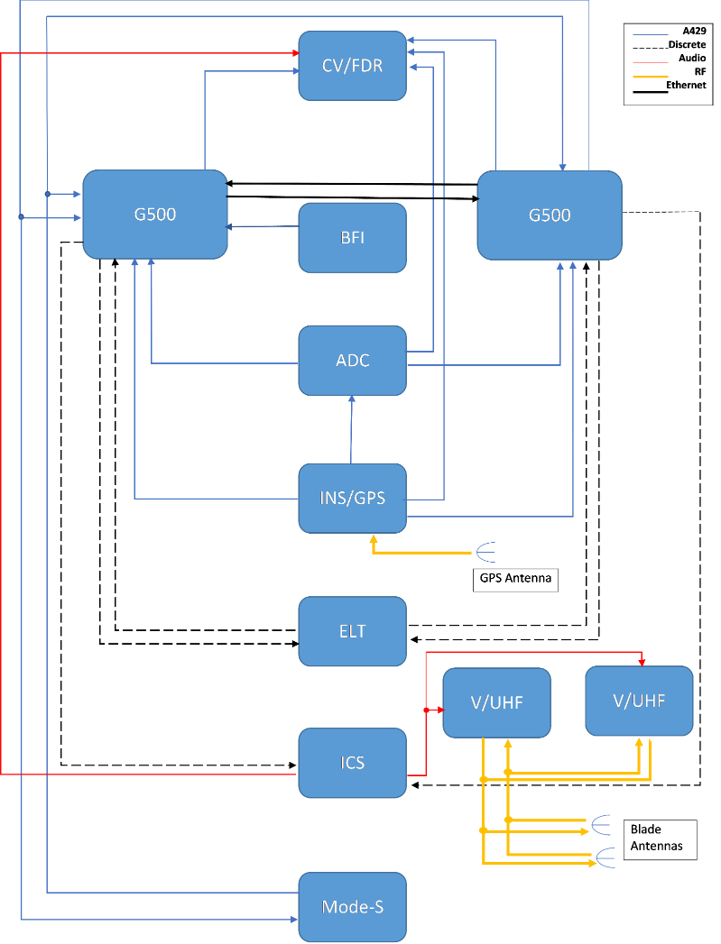
Aviyonik Mimari

Slide 13
Işıklandırma Malzeme Seçimi
İstenilen Ekipman | Seçilen Ekipman
Anti-Collision Light | AVEO Engineering RedBaron DayLite
Navigation Light | AVEO Engineering Andromeda DayLite

Slide 14
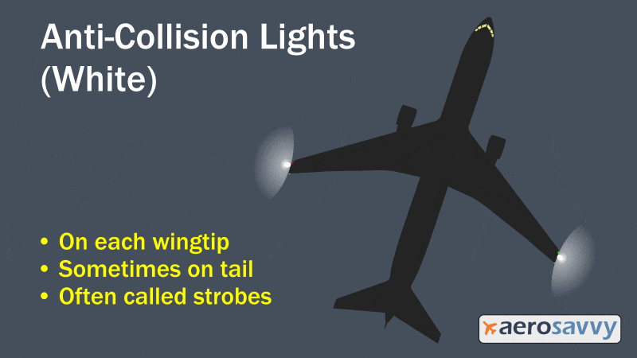
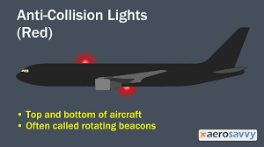
Anti-Collision Lights

Slide 15
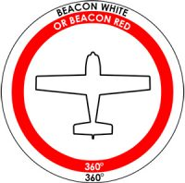
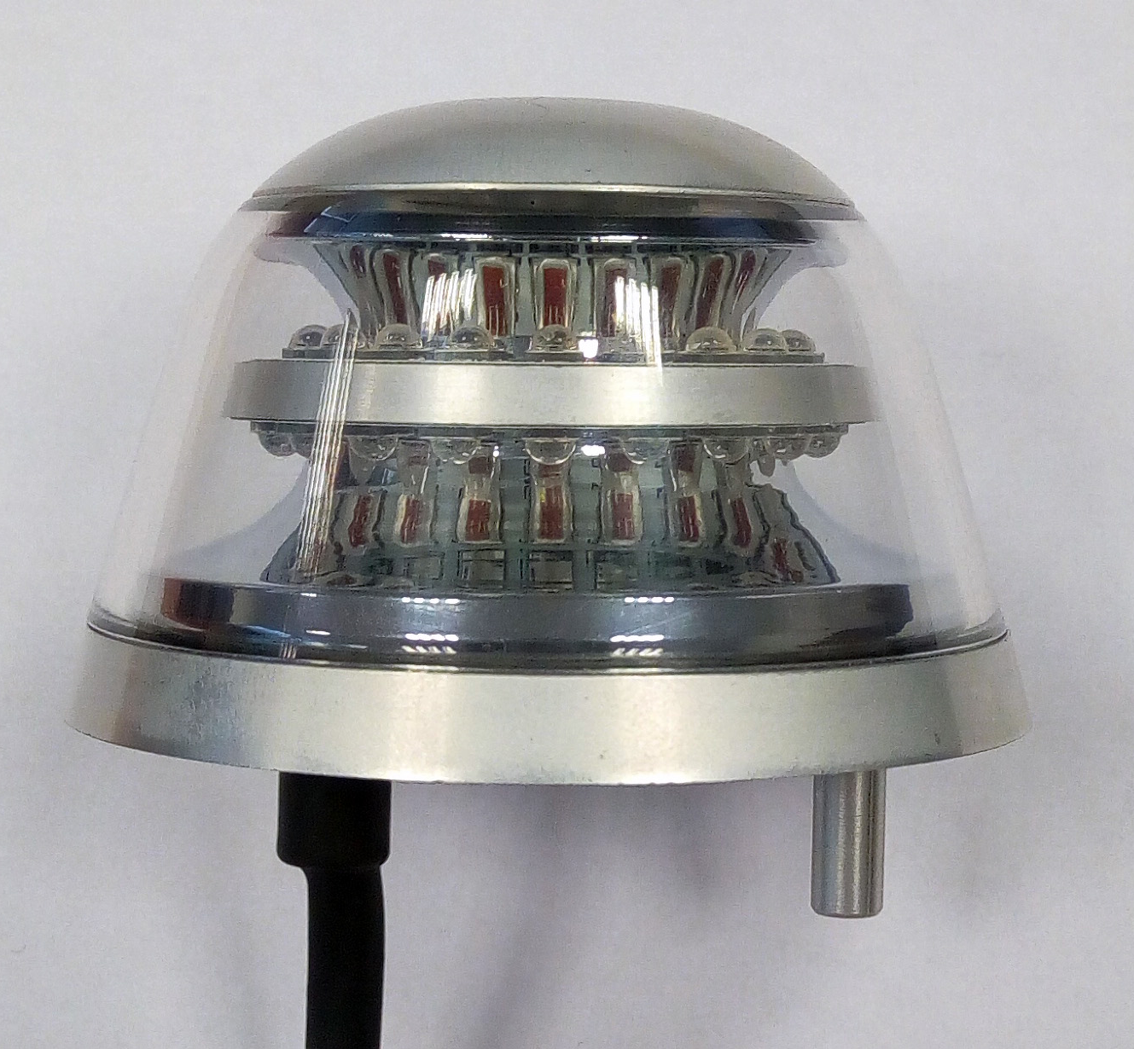
AVEO Engineering RedBaron DayLite
Anti-collision LED light – Red or White

Slide 16
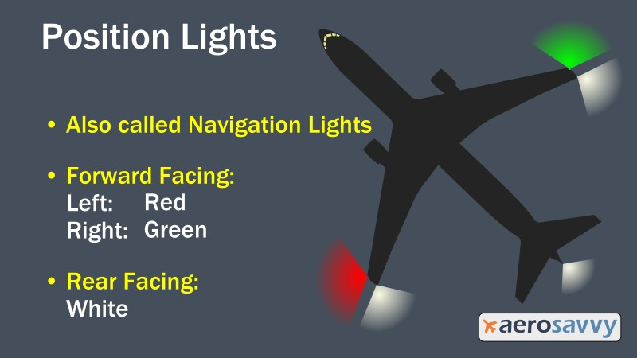
Navigation / Position Lights

Slide 17
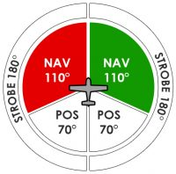
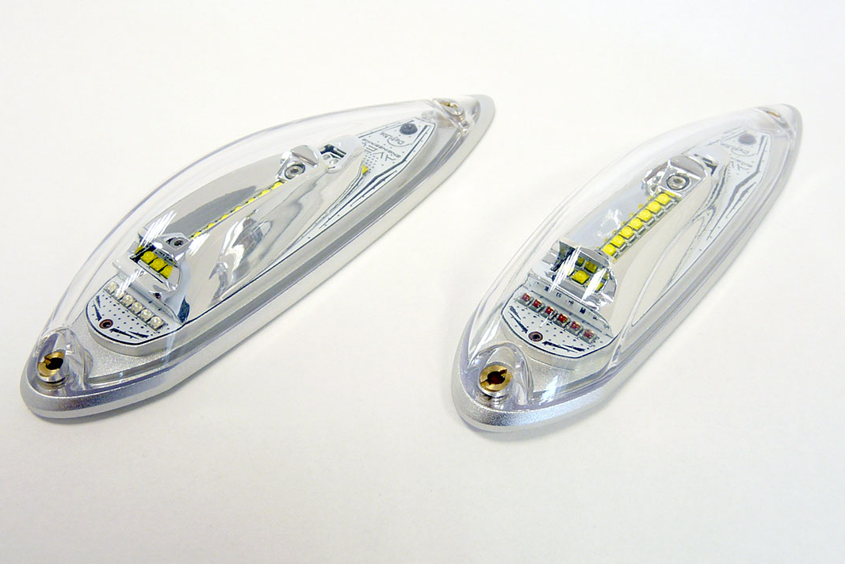
AVEO Engineering Andromeda DayLite
Navigation / Position / Strobe LED light

Slide 18
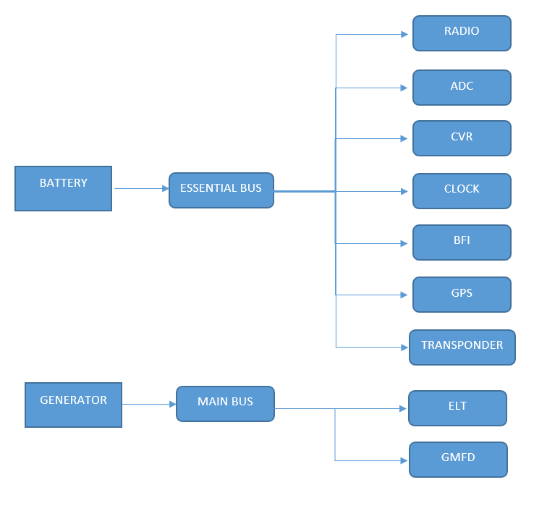
Elektrik Mimari

